Slide 1
Object-Oriented Analysis and Design using JAVA (20B12CS334)
B.Tech (CSE/IT) 5th SEM
2023-2024

Slide 2
Agenda
History of OOSD
Programming paradigms

Slide 3
Questions
What is the difference between procedural programming and object-oriented programming?
What are the four pillars of object-oriented programming, and briefly explain each?
Can you provide an example of a real-world entity and its representation as an object.

Slide 4
Brief history of object-oriented software development

Slide 5
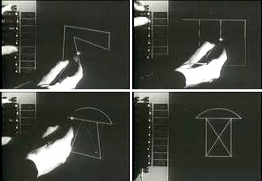
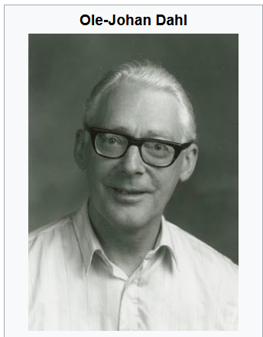
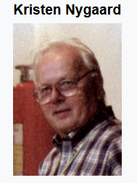
Brief history of object-oriented concepts
The term “object” in programming coined early 1960s, and used in several MIT projects such as Sketchpad (a computer program written by Ivan Sutherland- a pioneer of computer graphics- in 1963 in his PhD thesis-for which he was awarded Turing Award in 1988.
The Simula-language (1962) is recognized as a first programming language where the core concepts of object-oriented such as classes, objects, inheritance, polymorphism, and dynamic binding introduced.
Ole-Johan Dahl and Kristen Nygaard were a computer scientist and known as father of Simula object-oriented programming. Nygaard and Dahl received the 2001 A. M. Turing Award for their contribution to computer science.

Slide 6
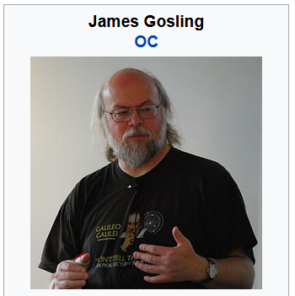
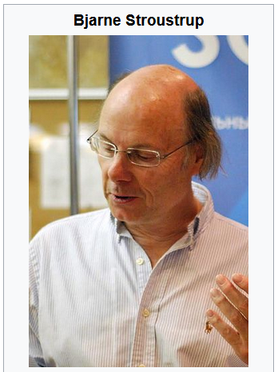
Palo Alto Research Center (PARC) developed Smalltalk in the early 1970’s. Smalltalk is considered the first truly object-oriented language.
1980 Booch pioneered the concept of object-oriented design (OOD). He authored the book "Object-Oriented Design with Applications" in 1991.
The concepts used in Simula has influenced in development of many other object-oriented programming. The Simula-type objects are reimplemented in C++, Object Pascal, Java, C#, and many other languages.
Computer scientists such as Bjarne Stroustrup, creator of C++ (1985), and James Gosling, creator of Java (1995), have acknowledged Simula as a major influence

Slide 7
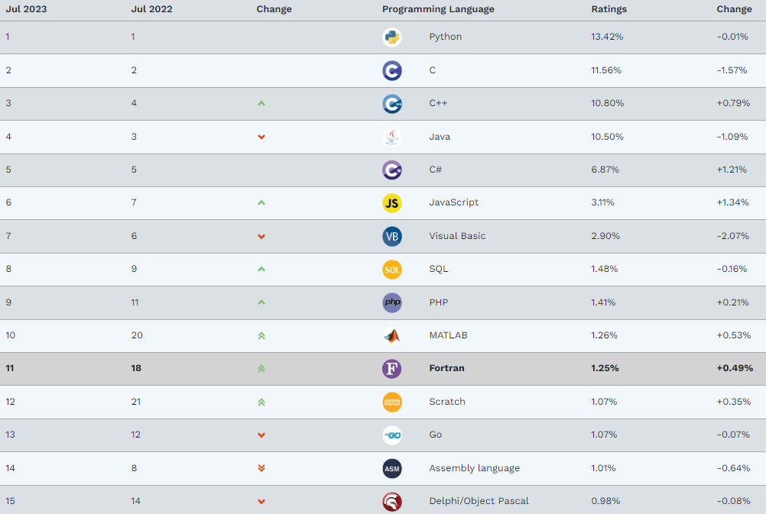
TIOBE Index for Jul 2023
The TIOBE Programming Community index is an indicator of the popularity of programming languages. The index is updated once a month. The ratings are based on the number of skilled engineers world-wide, courses and third party vendors
https://www.tiobe.com/tiobe-index/

Slide 8
Programming Paradigms

Slide 9
Introduction
Meaning of the word “paradigm” An example that serves as pattern or model. The American Heritage Dictionary of the English Language.
Paradigms emerge as the result of social processes in which people develop ideas and create principles and practices that embody those ideas by Thomas Kuhn, “The Structure of Scientific Revolutions”(published in 1962.)

Slide 10
Programming paradigm
Any fool can write code that a computer can understand. Good programmers write code that humans can understand. ― Martin Fowler, ThoughtWorks
Program with less complexity
Easier to debug and understand
Problem
Program with greater complexity
Difficult to debug and understand
Managing complexity is a programmer’s main concern. So how do programmers deal with complexity? There are many general approaches that reduce complexity in a program or make it more manageable. One of the main approaches is a programming paradigm. Let's dive into programming paradigms!
Notes:
the quote underscores the value of writing clean, maintainable, and understandable code. Good programming practices, such as using meaningful variable names, writing concise and self-explanatory comments, following coding conventions, and breaking down complex logic into smaller, logical units, all contribute to producing code that is not only functional but also easy for humans to work with. This approach leads to improved collaboration, reduced errors, and enhanced overall software quality.

Slide 11
The term programming paradigm refers to a style of programming. It does not refer to a specific language, but rather it refers to the way you program.
There are lots of programming languages that are well-known but all of them need to follow some strategy when they are implemented. And that strategy is a paradigm.

Slide 12
Introduction
Java
C++
Smalltalk
Eiffel
Ada++
Object oriented
PROLOG
GHC
Logical
ML
Scheme
Haskell
Lisp
CLOS
Functional
C
COBOL
FORTRAN
Ada
Pascal
Procedural
Imperative
(command driven)
Object-Oriented
Procedural
Declarative
(rule based)
Logical
Functional

Slide 13
Imperative programming paradigm
The paradigm consists of several statements, and after the execution of all of them, the result is stored. It’s about writing a list of instructions to tell the computer what to do step by step.
A collection of classes and object is used.
Basic entity: object that is used to perform every computation.
It gives emphasis on data instead procedure.
All kind of real life problem can be handled.
Advantage: Reusability, Inheritance, Security, and abstraction.
Object-oriented
paradigm
This paradigm emphasizes on procedure
No difference between procedural and imperative approach.
Advantage to reuse the code.
Procedural
paradigm

Slide 14
Declarative programming paradigm
The declarative paradigm focuses on what needs to be done instead of how it should be done. In this, programs are build by expressing logic of computation without defining the control flow.
Logical
paradigm
In this, focus is on knowledge base and the problem.
The program structure is like mathematical statement
The main concept is the function which define some specific computation.
Program is structured in such a way that if values are placed instead of function, the logic of the program should not change.
In this, Data is not much focused. It is loosely coupled to functions
Functional
paradigm

Slide 15
Further programming paradigm
Parallel process paradigm:- Parallel processing is the processing the instructions of program by dividing them among multiple processors.
Objective: Running a program in less time.
The system needs many processor to process the instructions.
Examples: C/C++ as some library function support this paradigm
Database programming paradigm:- This programming focuses on data and its movement.
Program structure defines data instead of series of steps.
Key area is in database programming for business information system.
Functionality: file creation, data entry, update, query and reporting functions
Example: SQL
Literate programming, as a form of imperative programming, structures programs as a human-centered web, as in a hypertext essay: documentation is integral to the program, and the program is structured following the logic of prose exposition, rather than compiler convenience.

Slide 16
Key references
Programming Languages: Principles and Paradigms by Maurizio Gabbrielli (Author), Simone Martini (Author).
https://www.geeksforgeeks.org/introduction-of-programming-paradigms/
https://cs.lmu.edu/~ray/notes/paradigms/#:~:text=A%20programming%20paradigm%20is%20a,thing%20(like%20a%20language).
https://en.wikipedia.org/wiki/Programming_paradigm

